Slide 1
OBJECT ORIENTED PROGRAMMING IT-203
PROJECT NAME - TRINITY TIC-TAC-TOE
REZUL BANSAL – 2K22/IT/134

Slide 2
INDEX
S. No. | Topic
1 | Trinity Tic Tac Toe
2 | What is Trinity Tic Tac Toe?
3 | Steps
4 | Winning Cases
5 | Code
6 | Output

Slide 3
TRINITY TIC-TAC-TOe
A game you have never heard of before…

Slide 4
WHAT IS TRINITY TIC-TAC-TOE ?
You must have played Tic-Tac-Toe before but Trinity Tic-Tac-Toe is not that simple to play and understand both.
Trinity Tic-Tac-Toe is a 2-player game.
Trinity Tic-Tac-Toe is basically related to game strategy.
In Trinity Tic-Tac-Toe, We have 3 Tic-Tac-Toe’s in one game and the rules for this game is same as that of Tic-Tac-Toe but the basic difference is that in Tic-Tac-Toe, we used both ‘O’ and ‘X’ but in this we use either of one of them.
Both the players have to fill the tic tac toe’s one by one and the further steps are provided in next slide.

Slide 5
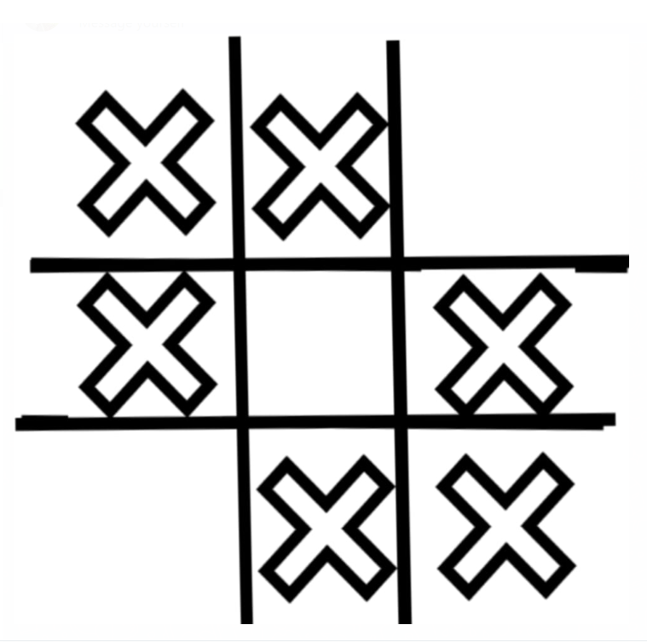
STEPS –>
# STEP 1->
Both the players take their turn one by one and they can mark ‘X’ in any of the 3 tic-tac-toe’s.
For example: if Player 1 fills in tic-tac-toe 1, then player 2 takes his turn and can fill in any other or same
tic-tac-toe too.
# STEP 2->
Now if any one of the tic-tac-toe gets filled by either of 8 winning cases, players cannot fill in that one and
will have to fill in the other 2.In simple words, that tic-tac-toe gets eradicated from the game. This happens till the 2 of them gets
eradicated.
# STEP 3->
Now if it comes to third one, the player winning this tic-tac-toe (means one of the 8 winning cases is filled) will actually lose this game, so the strategy here would to overcome winning the last tic-tac-toe left.

Slide 6
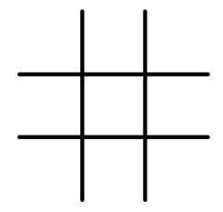
8 Winning Cases

Slide 7
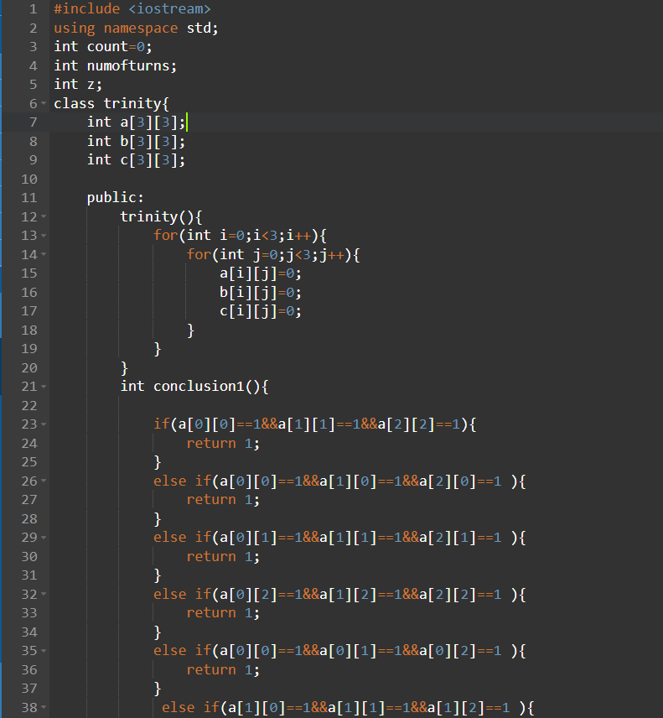
CODE

Slide 8
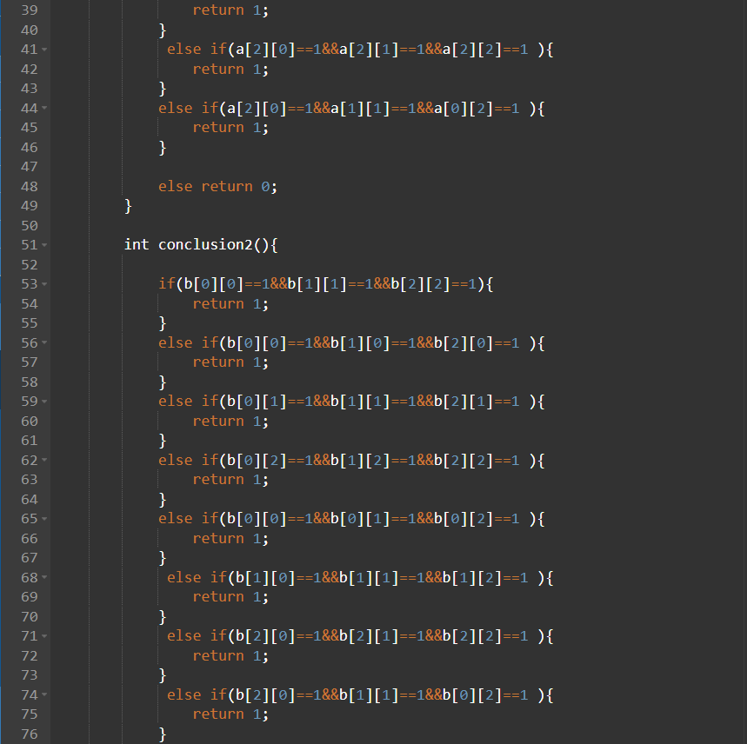

Slide 9
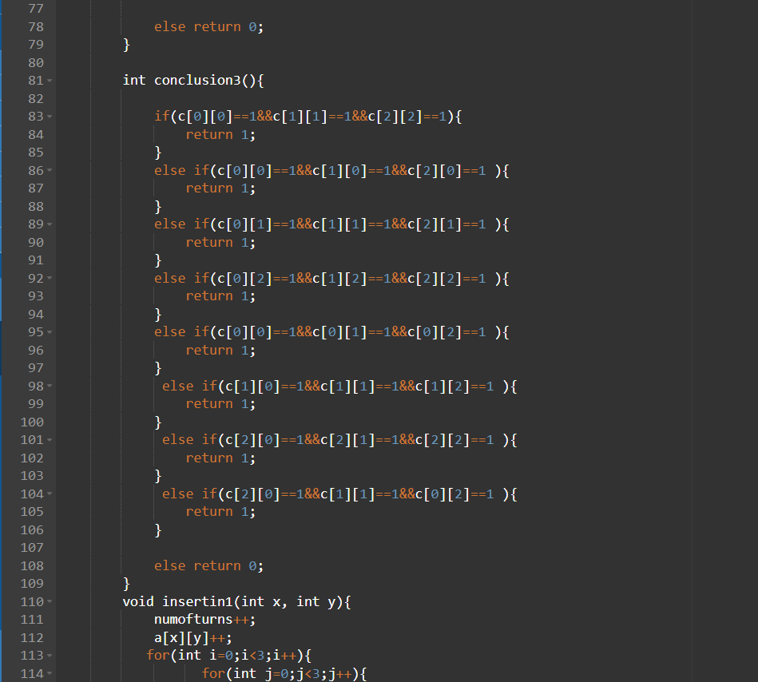

Slide 10
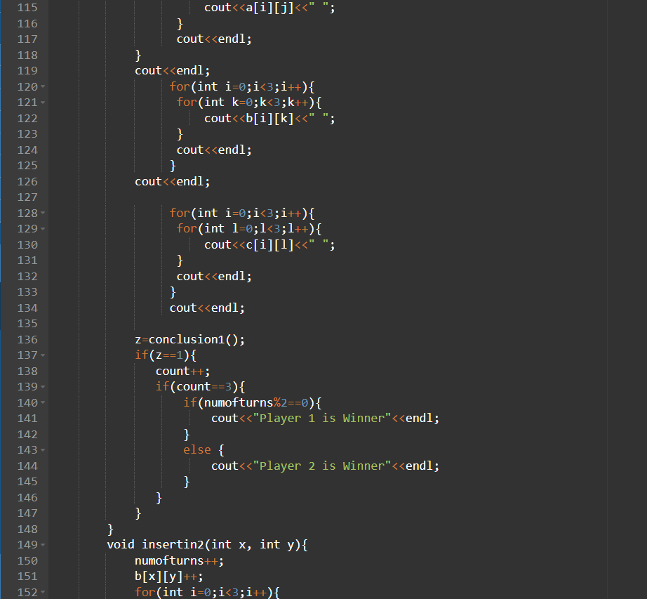

Slide 11
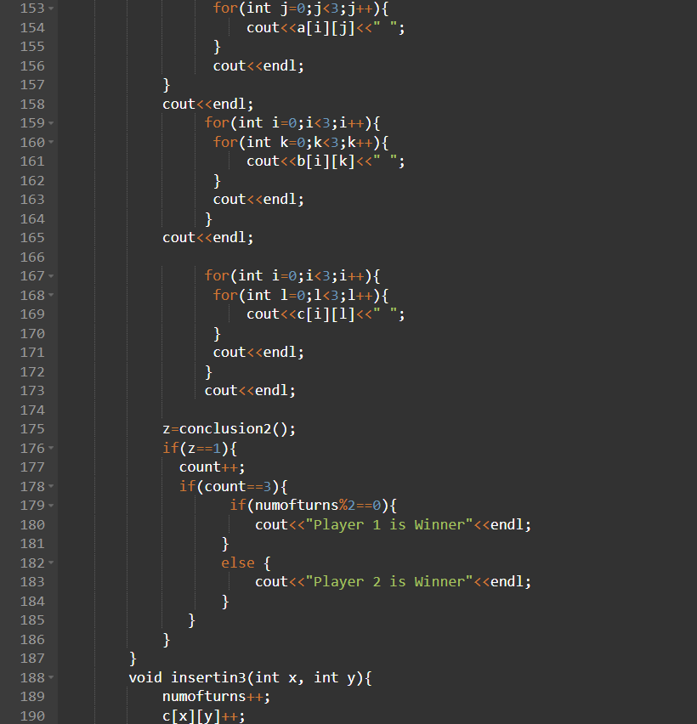

Slide 12
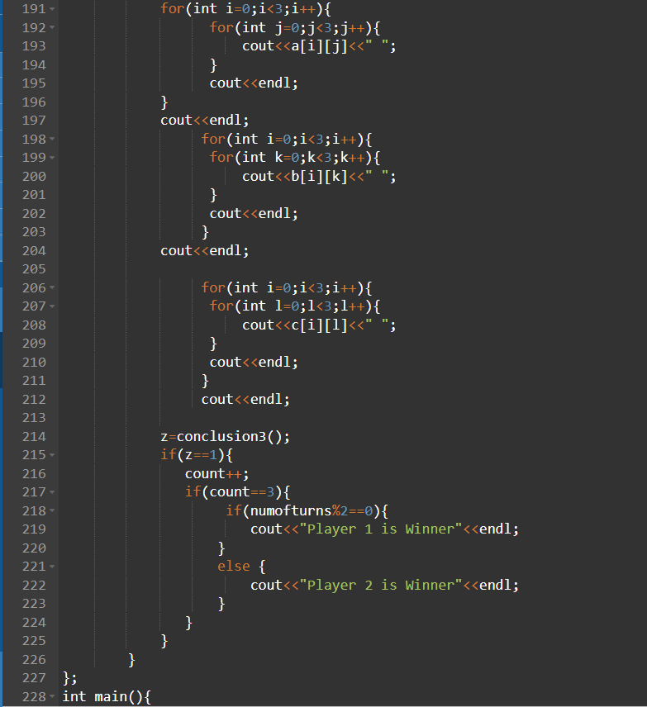

Slide 13
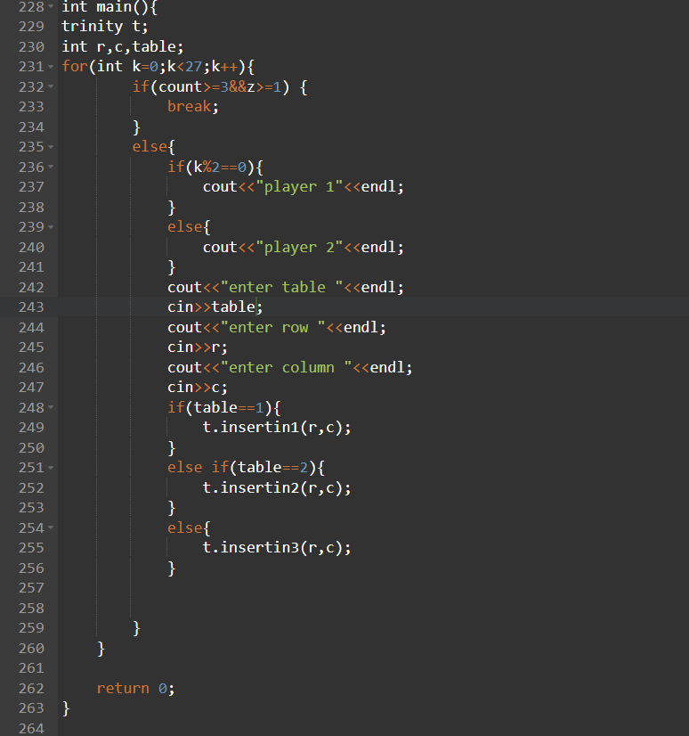

Slide 14
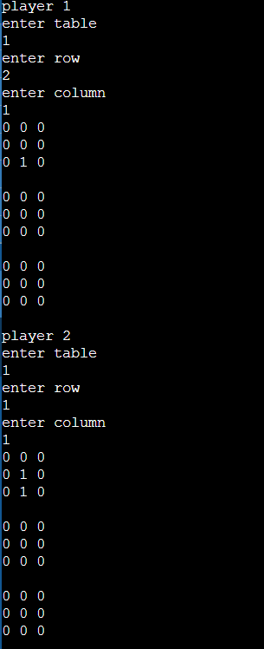
OUTPUT Player 1 starts the game followed by Player 2 till the game ends. In this output shown Player 1 chooses table 1 and (2,1) as (row , column) and output is shown below. Then Player 2 comes to play and chooses table 1 and (1,1) as (row , column) and its output is shown. This continues and if the third tic-tac-toe is filled with one of the 8 winning cases , then the Player playing at the end will lose and the other one wins.

Slide 15
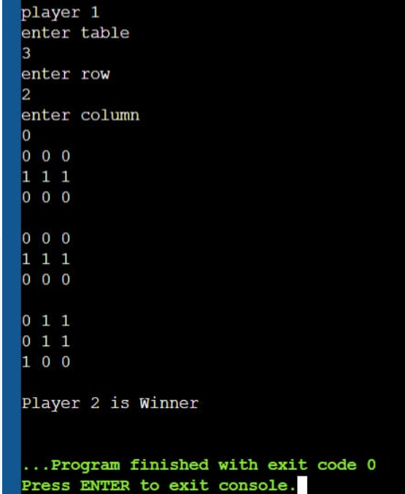
As seen in the output, Tic-Tac-Toe 1 and 2 gets eliminated and third one stays at the end and Player 1 ends the game, so Player 2 wins the game.

